Slide 1

Urban Mobility Data Analysis
SQL-Based Database Analysis Using MySQL
Presented by: Ananya Gadodia | Course: Data Analytics | Tools: MySQL Workbench · SQL

Slide 2


Project Overview
Thisprojectanalyzesanurbanmobilitydatabasespanning eight interconnected tables — users, drivers, vehicles, cities, rides, payments, promotions, and
ratings & feedback.
Core Objective
Use SQL to transform raw mobility data into meaningful operational and business insights — examining ride performance, user behavior, driver activity, and revenue patterns across cities and vehicle categories.

Slide 3
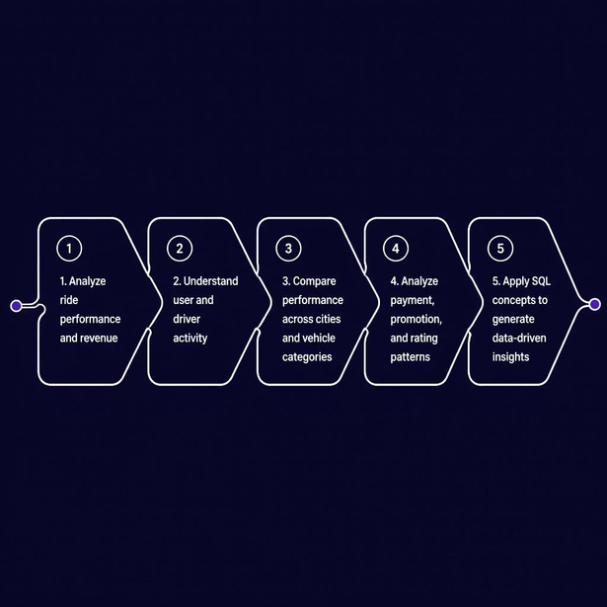
PROBLEM & OBJECTIVES
Problem Statement & Objectives
Urban mobility platforms generate large volumes of data across users, rides, drivers, vehicles, and payments. Manually analyzing these interconnected datasets is impractical — SQL provides a structured, repeatable approach to retrieve, compare, and derive insights.
• Managing interconnected mobility datasets
• Handling complex table relationships
• Ensuring data accuracy and consistency
• Comparing performance across cities and vehicle types • Converting SQL results into actionable insights

Slide 4
TECHNOLOGY
Technology Stack
MySQL
Relational database engine for storing and querying all mobility data.
MySQL Workbench
Primaryenvironment for writing queries, visualizing schemas, and reverse engineering.
8 Mobility Tables
Structureddatasetscovering users,
drivers, vehicles, cities, rides, payments, promotions, and ratings.
EER Diagram
Reverse-engineeredschema visualization showing keys, relationships, and constraints.
SQL Analysis
Aggregations,joins,subqueries, CTEs, and
window functions for deep data exploration.

Slide 5
DATA & DESIGN
Data Sources: 8 Relational Tables
Table
Purpose
users
User and customer profiles
drivers
Driver information and performance metrics
vehicles
Vehicle specifications and categories
cities
City names and tier classifications
rides
Core ride transaction records
payments
Payment transactions and status
promotions
Coupons, discounts, and offers
ratings_feedback
User and driver ratings and feedback

Slide 6

DATABASE DESIGN
Entity Relationship Diagram
Users
Customers with FK to CITIES (verified)
Drivers
Driverprofiles linked to RIDES
Vehicles
Cities
Citymaster table referenced by USERS
Vehiclerecords
associated with drivers

Slide 7
Data Flow
Raw data → Structured database →
METHODOLOGY
SQL analysis
→
Data-driven insights
Raw CSV Files
Relational SQL
Import to MySQL
Modeling

Slide 8
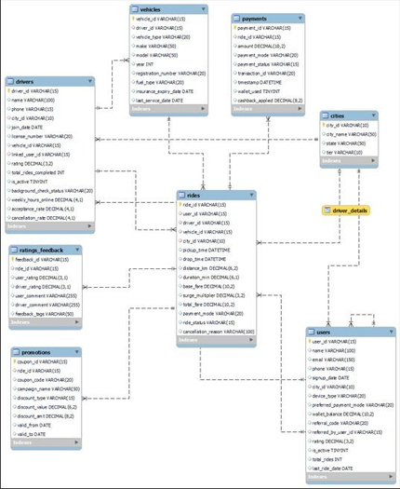
DATABASE DESIGN
MySQL Workbench Reverse Engineering
Reverse engineering was used to visualize the existing MySQL database structure — including all tables, primary keys, foreign keys, and inter-table relationships.
Key Distinction: The ER Diagram explains logical relationships. The Data Flow shows how data moves through the project. The Reverse Engineering / EER Diagram reflects the actual implemented MySQL schema.

Slide 9
METHODOLOGY
SQL Analysis Framework
Ouranalyticalapproachfollowsasystematicfive-stepframework,ensuringrobust data exploration and the derivation of meaningful business
intelligence from raw data.
Question
SQL Query
Result
Clearly define the business question or problem.
Construct targeted SQL queries for data retrieval.
Execute queries and retrieve the structured data output.
Comparison & Calculation
Insight & Judgement
Perform data analysis, comparisons, and metric calculations.
Translate findings into actionable insights and recommendations.
Example: To understand
payment_mode
revenue, we would first define the question ("Which payment modes generate the most revenue?"), then write a SQL query to
SUM
revenue
GROUP
BY payment_mode
, analyze the resulting totals, and finally derive insights on payment method performance.

Slide 10
01 | RIDE ACTIVITY & PERFORMANCE
Ride Activity & Performance
45,000
All ride requests initiated.
84.67%
Percentage of rides completed.
38,101
$3.84M
Rides successfully finished.
Total earnings from completed rides.
A high ride completion rate (84.67%) indicates strong operational efficiency and user satisfaction, minimizing lost revenue from unfulfilled requests.

Slide 11
02 | GROUPING & FILTERING AGGREGATED DATA
Grouping & Filtering Aggregated Data
City
Hyderabad
SQL Logic Flow
Mumbai
Kolkata
Pune
Completed
GROUP BY
HAVING
Rides
City
COUNT
>3000
Delhi
0
1k
2k
3k
4k
5k
Completed Rides
Insight: Hyderabad records the highest completed-ride volume among the cities meeting the 3,000-ride threshold.

Slide 12
03 | DATABASE OPERATIONS
Connecting the Database Through JOINs
Two compact relational diagrams show how JOINs connect related tables and produce richer datasets.
User–City JOIN
Ride–Payment JOIN
USERS user_id username city_id
→
CITIES city_id city_name
RIDES ride_id distance_km payment_id
→
PAYMENTS payment_id payment_mode amount_usd
JOI N
JOI N
users.city_id = cities.city_id
rides.payment_id = payments.payment_id
JOINs combine related tables to create richer analytical datasets.

Slide 13
04 | DATA TRANSFORMATION
Transforming Data with
CASE WHEN transforms numerical values into meaningful categories.
CASE WHEN
1
2
3
TOTAL FARE
CASE WHEN
LOW | MEDIUM | HIGH
Raw value
Conditional logic
Category
SELECT ride_id, total_fare, CASE
WHEN total_fare < 100 THEN 'Low'
WHEN total_fare BETWEEN 100 AND 300 THEN 'Medium' ELSE 'High'
END AS fare_category FROM rides;

Slide 14


Benchmarking with Subqueries
Users
Above-Average Completed Rides
OVERALL AVERAGE
Benchmark Reference
Drivers
Above-Average Rating
SUBQUERY + AVG()
SUBQUERY + AVG()
Result count:
Result count:
Completed Rides
Above-Average Fare
SUBQUERY + AVG()
≈100.67

Slide 15
06 | ADVANCED SQL
Advanced SQL Techniques
CTEs, Views and Window Functions for advanced data analysis.
Common Table Expressions
Views
Window Functions
Store reusable queries as virtual tables for simplified and consistent data access.
Perform calculations across related rows without collapsing the result.
Temporarily name complex queries to improve readability, modularity and multi- step analysis.
CREATE VIEW
RANK()
LAG()
WITH
Advanced SQL enables reusable, modular and row-level analysis.

Slide 16
KEY INSIGHTS
KEY INSIGHTS
SQL results turned into key observations
01
02
03
Operational Performance
Revenue Performance
Customer / Ride Value
Ride completion rate: 84.67%
Total revenue: $3.84M
Average fare: $100.67
Most initiated rides are successfully completed, indicating strong overall ride execution.
Completed rides generated substantial revenue across the analysed dataset.
The average completed ride provides a useful benchmark for understanding fare value.
Overall observation: The SQL analysis converts raw ride and transaction records into measurable indicators of operational and revenue performance.

Slide 17
Comparative Analysis
Rank
City
Completed Rides
Gap vs. #1
1
Hyderabad
4,883
0
2
Mumbai
4,469
414
3
Kolkata
4,218
665
4
Pune
4,000
883
5
Delhi
3,657
1,226
Highest: Hyderabad — 4,883 completed rides Lowest: Delhi — 3,657 completed rides
Hyderabad records the highest completed-ride volume, while Delhi records the lowest among the five cities.

Slide 18



FROM DATA TO INSIGHTS
Operational Performance
84.67%
Revenue & Customer Behaviour
$100.67
Geographic Performance
4,883 Rides (Hyderaba d)
Hyderabad leads in completed ride volume, highlightingakeyregional market strengthforfocusedgrowth.
High ride completion signifies strong
operational execution, minimizing revenue loss from unfulfilled requests.
Theaveragefarepercompletedride
provides a useful benchmark for understandingridevalueandpricing strategy.

Slide 19
Conclusion & Future Scope
Project Conclusion
Future Scope
Analyzedinterconnectedmobilitydatafrom 8 tables.
Developreal-timeperformance dashboards.
Identified patterns in rides, revenue, cities, payments, and campaigns.
Implement predictive analytics for demand forecasting.
Perform advanced customer segmentation.
Applied advanced SQL techniques for deeper insights.
Enhance driver performance monitoring.
Automate key reporting and alert systems.

Slide 20

THANK YOU
Questions & Discussion
Presented by Ananya Gadodia | Data Analytics

